Slide 1
Smart Lock Picking
Intermediate Presentation
by
Pia Fichtl, Benjamin Burse, Valerie Lemuth, Johanna Sacher

Slide 2

NFC
Technology, Locks and Attacks
Johanna Sacher 2019
Notes:
Talk about Locks that use Near Field Communication, NFC for short

Slide 3
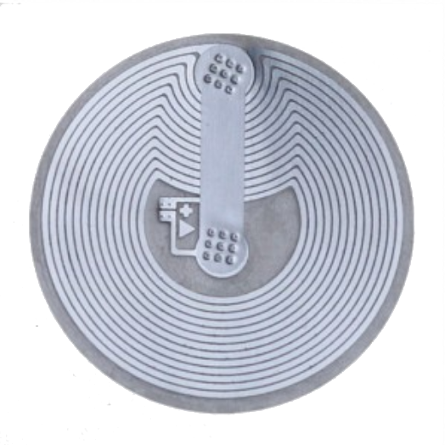
Technology
Technology
wireless communication between two devices in close proximity
-> Tag (passive) & Reader (active)
transmit data via radio waves
NFC Tag
Quelle: NFC-Tag-Shop
Johanna Sacher 2019
Notes:
NFC is a Communication standard that
Allows two devices to exchange data wirelessly
Those devices have to be really close together, in most cases less than 2 cm

Slide 4
Technology
Technology
wireless communication between two devices in close proximity
-> Tag (passive) & Reader (active)
transmit data via radio waves
NFC Tag
Quelle: NFC-Tag-Shop
Johanna Sacher 2019
Notes:
The idea is that you have a tag (which is basically a memory chip with a coiled antenna around it)
And this Tag is passive, it does not have any energy by itself
In addition you need a reader
The reader is active and activates the tag if it’s close enough

Slide 5
Technology
Technology
wireless communication between two devices in close proximity
-> Tag (passive) & Reader (active)
transmit data via radio waves
NFC Tag
Quelle: NFC-Tag-Shop
Johanna Sacher 2019
Notes:
Once activated, they transmit data via radio waves
It works like this: (next slide)

Slide 6
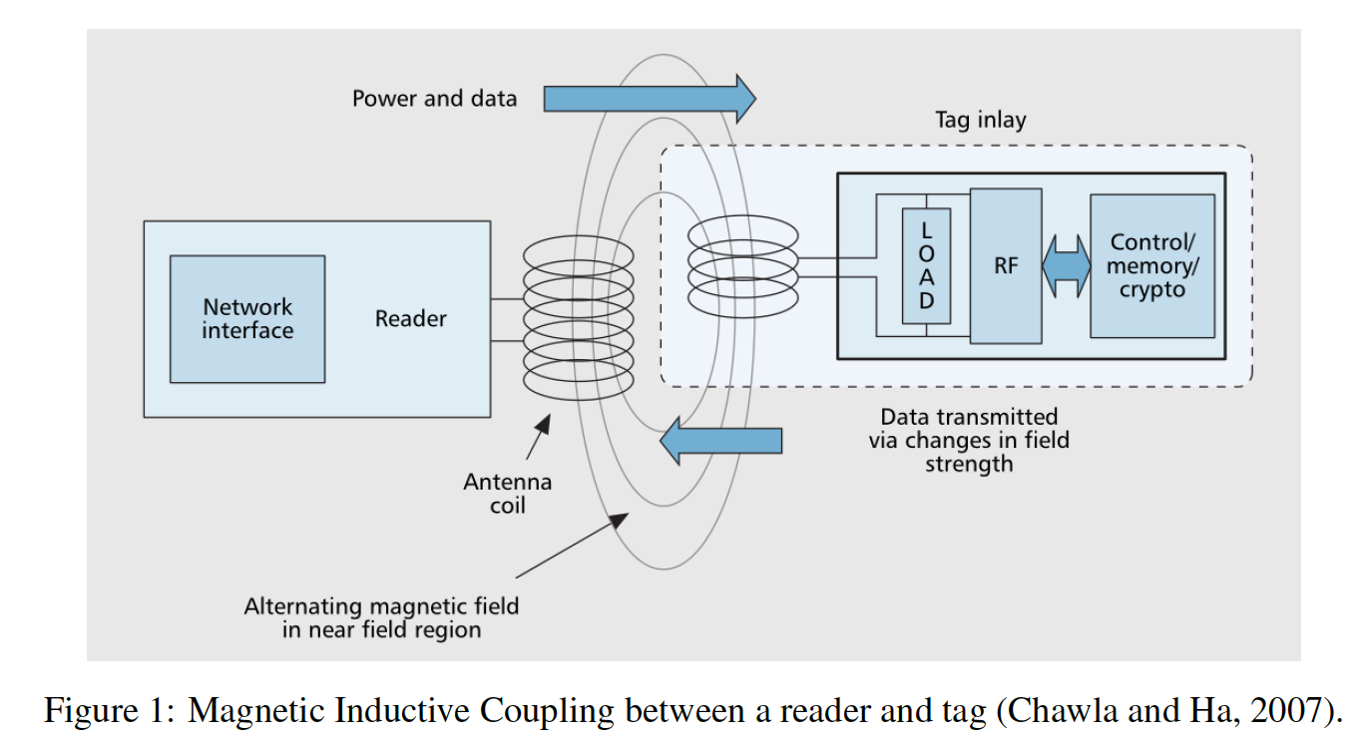
Technology
Johanna Sacher 2019
Quelle : Access granted: On the Security of Near - Field Enabled Keycards (Stephen J. Jones
Notes:
The reader generates an electromagnetic field and sends a signal to the tag
The tag can now send the data from it’s memory chip via this field

Slide 7
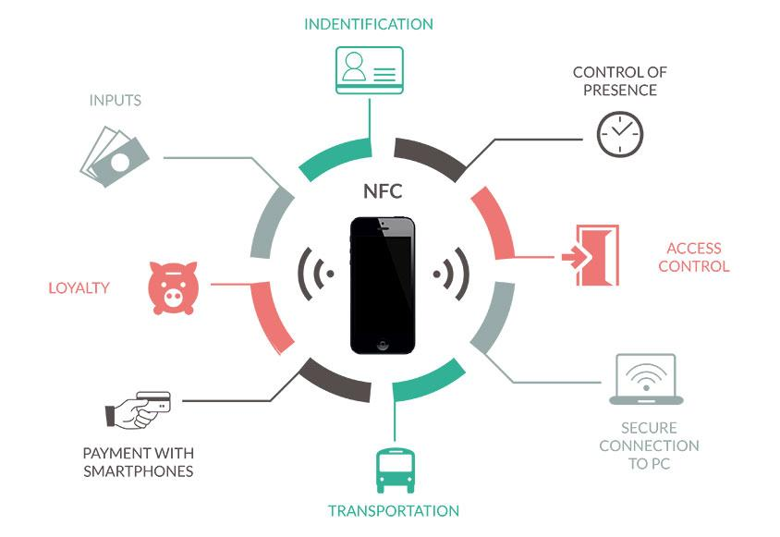
Technology
Quelle : Wonderful NFC Projects to arouse your ideas
Johanna Sacher 2019
Notes:
we all know and use nfc nearly every day - the Thoska has an encrypted nfc tag for access control, identification and payment

Slide 8
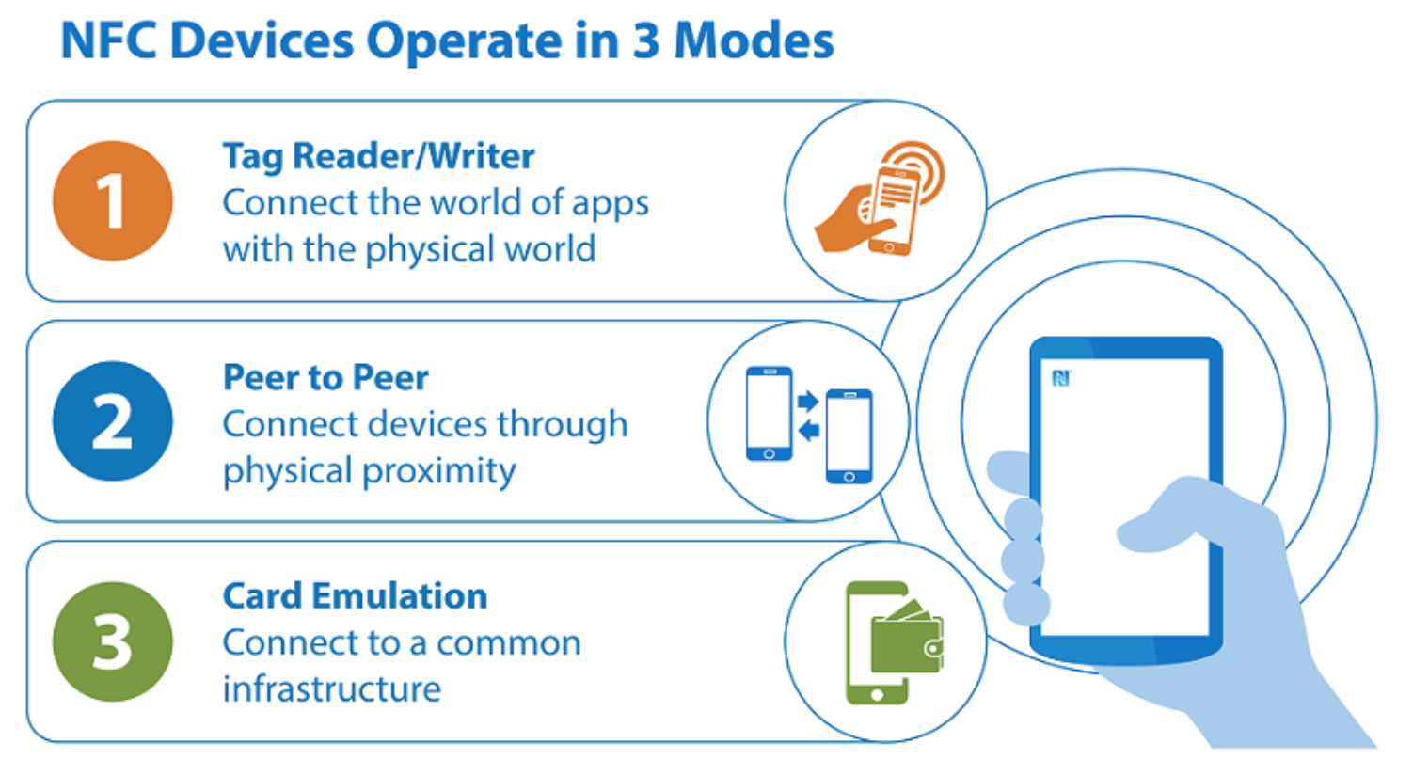
Technology
Johanna Sacher 2019
Quelle : nfc-forum.org
Notes:
NFC basically has three operating modes, the one that is interesting for us is the third one.
We want to emulate keys (say NFC-Tags) to get NFC Locks to accept us as valid user
There are some possible attacks we can try with nfc and I just want to give a quick overview:

Slide 9
Possible Attacks
Phishing
Skimming
Relay Attack
Johanna Sacher 2019
Notes:
For one there is ofe course Phishing
Which is trying to get sensible data of naive users, for example by manipulating or trying to trick them
(in this case that could mean trying to get the nfc tag (‘oh, I forgot my thoska, could you lend me yours, I just have to access that building later, it’s rather important!’) or letting you scan and save their tag (if possible))

Slide 10
Possible Attacks
Phishing
Skimming
Relay Attack
Johanna Sacher 2019
Notes:
Then there is skimming, which is the
unauthorised reading of data
In this case that could be credit cards or the Thoska, when someone hands them to you when they are paying
But they don’t even have to give it to you, it’s enough to be near enough
many people wear their entry-cards carelessly outside of their clothes so it’s not hard to scan them, say in a crowded subway or in the queue in the cafeteria
once scanned you can save the data and replay it later in front of a nfc reader - if the scanned tag was not encrypted you just emulated the tag and will be accepted
some tags can be encrypted though and the standard encryption mostly used today is not broken yet (e.g. the thoska)

Slide 11
Possible Attacks
Phishing
Skimming
Relay Attack
Johanna Sacher 2019
Notes:
And the third one are relay attacks

Slide 12
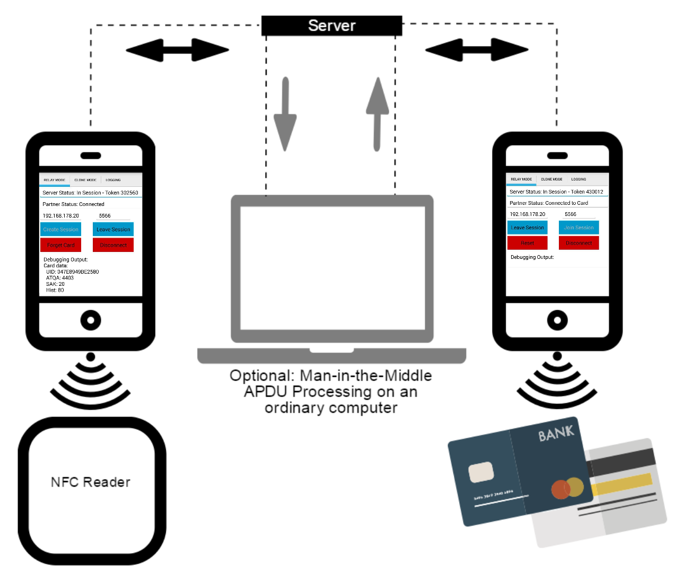
Possible Attacks
Relay Attack
Quelle : NFCGate
Johanna Sacher 2019
Notes:
They work like this:
You need two phones, one reads the NFC Tag and sends the data to a server
The other phone, too, is connected to that server, gets the Tag-data and this way emulates the tag
We hold it in front of a reader and the reader thinks we are the tag and accepts us
This works over great distances, which is cool and kind of scary

Slide 13
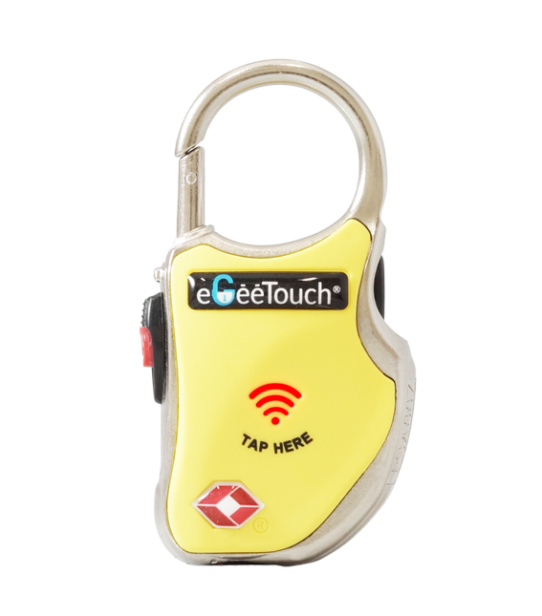
Smart Travel Padlock
How it works
What I tried
Skimming
Relay Attack
Conclusion
Press Power Button until Beep
Hold NFC Tag in front of ‘TAP HERE’
Lock Beeps and opens
close: press Power until 2x Beep
Quelle : eGeeTouch
Johanna Sacher 2019
Notes:
(SHOW)
Press Power Button until its Beeps
Hold NFC Tag in front of ‘TAP HERE’
Lock opens
to close: press Power until it Beeps twice

Slide 14
Smart Travel Padlock
How it works
Attacks I tried
Skimming
Relay Attack
Conclusion
Quelle : eGeeTouch
Johanna Sacher 2019
Notes:
first I wanted to use the app nfcProxy which claims to be able to read, save and replay nfc Data
nfcProxy requires a custom ROM - cyanogenmod - which is not developed any more and hard to find, so I tried lineageOS instead
that did not work, NFC was disabled in this ROM
So then I tried several older versions and even found a cyanogenmod .zip, but that did not work either.
Eventually I gave up and took a closer look at nfcGate

Slide 15

Smart Travel Padlock
How it works
Attacks I tried
Skimming
Relay Attack
Conclusion
Quelle : eGeeTouch
Johanna Sacher 2019
Notes:
NFCGate was built by the TU Darmstadt for researching purposes - they have several modes, one for cloning, one for relay and one for replay
the apk started but didn’t really work yet
luckily they had written some good instructions

Slide 16
Smart Travel Padlock
How it works
Attacks I tried
Skimming
Relay Attack
Conclusion
→ root android phone
→ install xposed, activate module
for nfcGate
Quelle : eGeeTouch
Johanna Sacher 2019
Notes:
so I had to root the phone, install the xposed framework, restart the phone and everything should be fine
easier said than done, but eventually I figured it out and got the app to work
from here on it was very easy

Slide 17

Smart Travel Padlock
How it works
Attacks I tried:
Skimming
Relay Attack
Conclusion
NFCGate - TU Darmstadt
clone data and replay in front of lock
save data and replay later
Quelle : eGeeTouch
Johanna Sacher 2019
Notes:
(SHOW - AndroidAir!!)
I just read the Tag with the phone, activate the lock and hold the phone in front of the reader and the lock beeps and opens
I can also save multiple datasets and replay them any time later (show!)
(close the lock!)

Slide 18
Smart Travel Padlock
How it works
Attacks I tried:
Skimming
Relay Attack
Conclusion
NFCGate - TU Darmstadt
Quelle : eGeeTouch
Johanna Sacher 2019
Notes:
there are different modes in the app (show)
we just used the default, the Clone Mode
what I found very interesting right from the beginning was the relay attack (because it works over great distances)
so next I wanted to try that one, but you need two phones to do that

Slide 19
Smart Travel Padlock
How it works
Attacks I tried:
Skimming
Relay Attack
Conclusion
NFCGate - TU Darmstadt
2 rooted phones with nfcGate App
running server (python)
connect phones to the Internet
one emulates the tag, one emulates the phone
Quelle : eGeeTouch
Johanna Sacher 2019
Notes:
so I got a second nexus 5, rooted it and installed xposed and nfcGate
then I cloned the server repository from the developers of nfcGate
the server runs without a problem, it’s a simple python script
of course both phones have to be connected to the internet
(SHOW)
then we choose one phone to emulate the reader and put it on the tag
the other one receives this data and emulates the tag, so we hold it in front of the lock
and if we are lucky it opens up

Slide 20
Smart Travel Padlock
How it works
What I tried
Skimming
Relay Attack
Conclusion
not very safe
possibly a feature but not a good one
Quelle : eGeeTouch
Johanna Sacher 2019
Notes:
so in conclusion this lock is not very safe
that might be a feature, this way you can open your lock with your smartphone or smartwatch
but it’s definitely not a good feature, it’s not safe and very easy to abuse

Slide 21
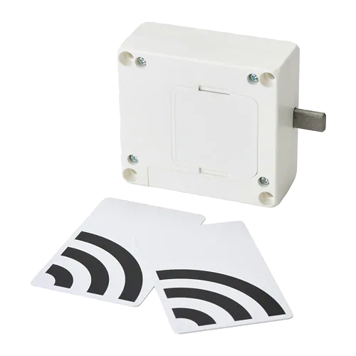
IKEA Rothult Lock
How it works
What I tried
Problems
Bug
Conclusion
Quelle : IKEA
Johanna Sacher 2019
Notes:
This is the next lock I had a look at
It’s a lock for a drawer
You can buy it for 20 € from IKEA and it’s called Rothult

Slide 22
IKEA Rothult Lock
How it works
What I tried
Problems
Bug
Conclusion
hold Master Key Card on lock
lock opens/closes
additional key (always just one at a time!):
hold nfc tag on lock while it’s open
every nfc device/tag is supposed to work
Quelle : IKEA
Johanna Sacher 2019
Notes:
To open or close it you just hold one of the Master Key cards on it
One of the features is that you can add ONE additional key, and only ONE at a time
To do that you hold any nfc tag or device on the lock while it’s open
(Thoska)
So now I can use the Thoska as an additional key to open and close this lock
To reset it I can just take the batteries out

Slide 23
IKEA Rothult Lock
How it works
What I tried
Problems
Bug
Conclusion
Quelle : IKEA
Johanna Sacher 2019
Notes:
was really enthusiastic and hoped that everything I did before would just work the same way
it did not
but before I found that out I found an interesting bug

Slide 24
IKEA Rothult Lock
How it works
What I tried:
Bugs
Bug
Conclusion
Multiple additional keys
Not all devices are accepted
Quelle : IKEA
Johanna Sacher 2019
Notes:
Just out of interest I tried to add my phone as additional key and discovered, that
you can use as many additional key at a time as you like
I used two thoskas, my phone and the tag from the travel padlock all at the same time and it worked
the nexus phones did not work though, they were always rejected
so that’s not really safe, as soon as someone catches the lock unlocked he/she can just “make a new key”

Slide 25
IKEA Rothult Lock
How it works
What I tried:
Bug
Problem
Conclusion
Encrypted tag
Nexus 5 is not accepted as additional key
Quelle : IKEA
Johanna Sacher 2019
Notes:
Then I wanted to try the same attacks I used before
reading in the cards was no problem but the nexus still was always rejected from the lock
so it was hard to decide whether it was a problem with the lock or the app or if it was just the wrong phone
in short none of the attacks worked and I just wasn’t sure what exactly was the problem
so I scanned the KeyCards with another app, did the same with the Travel Tag and compared the scan reports
the KeyCards (and the Thoska) are Type 4 Tags, those are tags that can be encrypted and the encryption is not broken yet
so I assume that is the reason the attacks did not work - but I can’t be sure because I can’t use a phone that is accepted as additional key for the attacks

Slide 26
IKEA Rothult Lock
How it works
What I tried:
Bug
Problem
Idea
Conclusion
copy additional key of type-2 (not encrypted) to empty tag
Quelle : IKEA
Johanna Sacher 2019
Notes:
one idea we had to go around the problem with the encrypted tag was to add the travel tag as additional key
this one is a type 2 tag which can not be encrypted
so if we copy the data from that chip we should get access
again: the problem remains that the nexus is always rejected by the lock
so I got empty nfc tags which in theory can be written on
there are several apps to do that, to even copy the content of one tag to another one - all of those did not work
so next we got a nfc reader which can be connected to a computer via usb
at the moment I’m using nfcpy to try to read a tag via this reader (which works) and copy the content to an empty tag (which doesn’t work so far)

Slide 27
IKEA Rothult Lock
How it works
What I tried
Bug
Problem
Idea
Conclusion
Quelle : IKEA
Good enough (20€)
Has its faults
Johanna Sacher 2019
Notes:
basically it seems to be a good lock, the KeyCards are encrypted, so somebody thought about safety
on the other hand: the feature to add additional keys is a big security leak and also does not work the way it should
for a normal office drawer (and for 20 euros) it seems ok, but there are definitely faults

Slide 28
Fingerprint Locks
Valerie Lemuth
Intermediate presentation

Slide 29
Topics
Overview - Fingerprint Recognition Systems
Functionality Of Capacitive Scanners
The Attacks

Slide 30
Overview - Fingerprint Recognition Systems
Registration:
Verification:

Slide 31
Overview - Fingerprint Recognition Systems
Registration:
Finger
Verification:

Slide 32
Overview - Fingerprint Recognition Systems
Registration:
Placed on
Finger
Scanner
Verification:

Slide 33
Overview - Fingerprint Recognition Systems
Registration:
Placed on
Finger
Scanner
- optical
Verification:
- capacitive
- ultrasonic

Slide 34
Overview - Fingerprint Recognition Systems
Registration:
Placed on
Finger data
Extraction of minutiae
Finger
Scanner
Verification:

Slide 35

Overview - Fingerprint Recognition Systems
Registration:
Placed on
Finger data
Extraction of minutiae
Finger
Scanner
Verification:
Ridge ending
Ridge dot
Ridge bifurcation
https://www.bayometric.com/minutiae-based-extraction-fingerprint-recognition/

Slide 36
Overview - Fingerprint Recognition Systems
Registration:
Placed on
Finger data
Stored
Extraction of minutiae
Finger
Scanner
Database
Verification:

Slide 37
Overview - Fingerprint Recognition Systems
Registration:
Placed on
Finger data
Stored
Extraction of minutiae
Finger
Scanner
Database
Verification:
Placed on
Finger data
Extraction of minutiae
Finger
Scanner

Slide 38
Overview - Fingerprint Recognition Systems
Registration:
Placed on
Finger data
Stored
Extraction of minutiae
Finger
Scanner
Database
Verification:
Placed on
Finger data
Extraction of minutiae
Finger
Scanner
Comparison

Slide 39
Overview - Fingerprint Recognition Systems
Registration:
Placed on
Finger data
Stored
Extraction of minutiae
Finger
Scanner
Database
Verification:
References
Placed on
Finger data
Extraction of minutiae
Finger
Scanner
Comparison

Slide 40
Overview - Fingerprint Recognition Systems
Registration:
Placed on
Finger data
Stored
Extraction of minutiae
Finger
Scanner
Database
Verification:
References
Placed on
Finger data
Extraction of minutiae
Finger
Scanner
Comparison
Accept or Decline

Slide 41
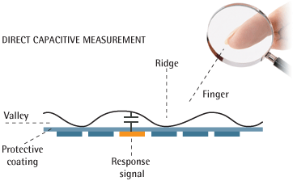
Functionality Of Capacitive Scanners
http://biometrics.mainguet.org/types/fingerprint/fingerprint_sensors_physics_electr.htm

Slide 42
Functionality Of Capacitive Scanners
http://biometrics.mainguet.org/types/fingerprint/fingerprint_sensors_physics_electr.htm
- Most common method, is used in our smartlocks!

Slide 43
Functionality Of Capacitive Scanners
Takes a “picture” using capacitors!
http://biometrics.mainguet.org/types/fingerprint/fingerprint_sensors_physics_electr.htm
- Most common method, is used in our smartlocks!

Slide 44
Functionality Of Capacitive Scanners
Takes a “picture” using capacitors!
http://biometrics.mainguet.org/types/fingerprint/fingerprint_sensors_physics_electr.htm
- Most common method, is used in our smartlocks!
- Conclusions of the first presentation:

Slide 45
Functionality Of Capacitive Scanners
Takes a “picture” using capacitors!
http://biometrics.mainguet.org/types/fingerprint/fingerprint_sensors_physics_electr.htm
- Most common method, is used in our smartlocks!
- Conclusions of the first presentation:
—> Very hard to fool

Slide 46
Functionality Of Capacitive Scanners
Takes a “picture” using capacitors!
http://biometrics.mainguet.org/types/fingerprint/fingerprint_sensors_physics_electr.htm
- Most common method, is used in our smartlocks!
- Conclusions of the first presentation:
—> Very hard to fool
—> Gummy fingers have the wrong material

Slide 47
Functionality Of Capacitive Scanners
Takes a “picture” using capacitors!
http://biometrics.mainguet.org/types/fingerprint/fingerprint_sensors_physics_electr.htm
- Most common method, is used in our smartlocks!
- Conclusions of the first presentation:
—> Very hard to fool
—> Gummy fingers have the wrong material
—> BUT: Security depends on the amount of capacitors and quality of the software

Slide 48
The Attacks
Main Attack Types:
1. Tricking the fingerprint scanner
2. Attacking the padlock hardware
3. Attacking the software

Slide 49
The Attacks
1. Tricking The Fingerprint Scanner:

Slide 50
The Attacks
1. Tricking The Fingerprint Scanner:
- Method:

Slide 51
The Attacks
1. Tricking The Fingerprint Scanner:
- Method:
- Create mold out of play-doh/molding plastic & press finger into it

Slide 52
The Attacks
1. Tricking The Fingerprint Scanner:
- Method:
- Create mold out of play-doh/molding plastic & press finger into it
- Fill mold with gelatine/liquid silicone

Slide 53
The Attacks
1. Tricking The Fingerprint Scanner:
- Method:
- Create mold out of play-doh/molding plastic & press finger into it
- Fill mold with gelatine/liquid silicone
- Wait for it to harden/chill & use!

Slide 54
The Attacks
1. Tricking The Fingerprint Scanner:
- Material for the finger (the liquid):

Slide 55
The Attacks
1. Tricking The Fingerprint Scanner:
- Material for the finger (the liquid):
- Gelatine

Slide 56
The Attacks
1. Tricking The Fingerprint Scanner:
- Material for the finger (the liquid):
- Gelatine
—> Easy to obtain

Slide 57
The Attacks
1. Tricking The Fingerprint Scanner:
- Material for the finger (the liquid):
- Gelatine
—> Easy to obtain
—> Out of animal products & therefore closer to human fingers

Slide 58
The Attacks
1. Tricking The Fingerprint Scanner:
- Material for the finger (the liquid):
- Gelatine
—> Easy to obtain
—> Out of animal products & therefore closer to human fingers
—> Best ratio: 30g gelatine and 30ml hot water

Slide 59
The Attacks
1. Tricking The Fingerprint Scanner:
- Material for the mold:

Slide 60
The Attacks
1. Tricking The Fingerprint Scanner:
- Material for the mold:
- Play-doh:

Slide 61
The Attacks
1. Tricking The Fingerprint Scanner:
- Material for the mold:
- Play-doh:
—> Melts because of the hot gelatine

Slide 62
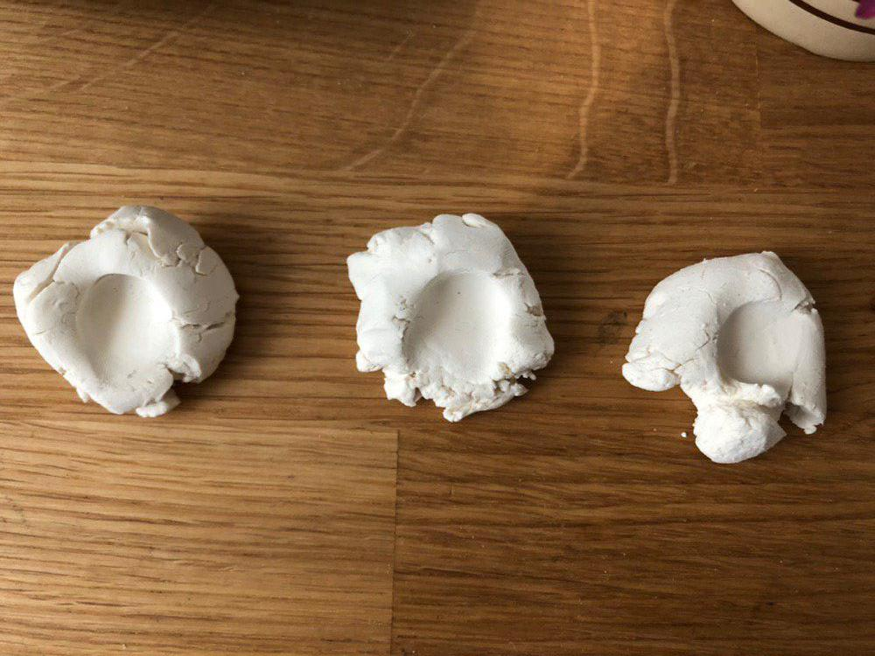
The Attacks
1. Tricking The Fingerprint Scanner:
- Material for the mold:
- Play-doh
- Modelling clay:

Slide 63
The Attacks
1. Tricking The Fingerprint Scanner:
- Material for the mold:
- Play-doh
- Modelling clay:
—> Dries out to quickly

Slide 64
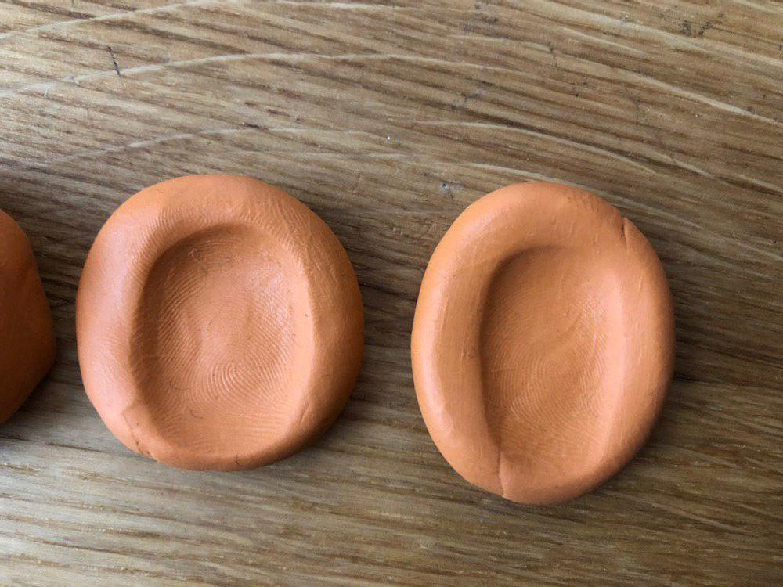
The Attacks
1. Tricking The Fingerprint Scanner:
- Material for the mold:
- Play-doh
- Modelling clay
- Fimo:

Slide 65
The Attacks
1. Tricking The Fingerprint Scanner:
- Material for the mold:
- Play-doh
- Modelling clay
- Fimo:
—> Hardens completely & can be reused

Slide 66
The Attacks
1. Tricking The Fingerprint Scanner:
- Best combination:

Slide 67
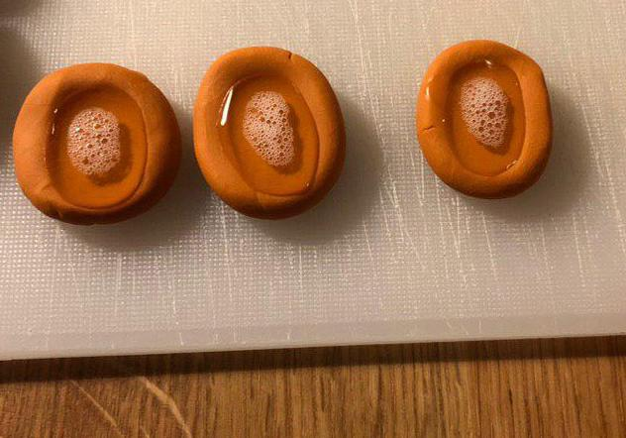
The Attacks
1. Tricking The Fingerprint Scanner:
- Best combination:
- Fimo and viscous gelatine:

Slide 68
The Attacks
1. Tricking The Fingerprint Scanner:
- Best combination:
- Fimo and viscous gelatine:
—> Unfortunately, the gummy finger couldn’t fool the scanner

Slide 69
The Attacks
1. Tricking The Fingerprint Scanner:
- Possible ideas why it didn’t work:

Slide 70
The Attacks
1. Tricking The Fingerprint Scanner:
- Possible ideas why it didn’t work:
- Temperature sensitivity:

Slide 71
The Attacks
1. Tricking The Fingerprint Scanner:
- Possible ideas why it didn’t work:
- Temperature sensitivity:
—> Thin gelatine over real finger

Slide 72
The Attacks
1. Tricking The Fingerprint Scanner:
- Possible ideas why it didn’t work:
- Temperature sensitivity:
—> Thin gelatine over real finger
—> No difference, sensor is probably not temperature sensitive

Slide 73
The Attacks
1. Tricking The Fingerprint Scanner:
- Possible ideas why it didn’t work:
- Temperature sensitivity:
—> Thin gelatine over real finger
—> No difference, sensor is probably not temperature sensitive
- Different conductivity:

Slide 74
The Attacks
1. Tricking The Fingerprint Scanner:
- Possible ideas why it didn’t work:
- Temperature sensitivity:
—> Thin gelatine over real finger
—> No difference, sensor is probably not temperature sensitive
- Different conductivity:
—> Using conductive varnish (“Leitlack”)

Slide 75
The Attacks
1. Tricking The Fingerprint Scanner:
- Possible ideas why it didn’t work:
- Temperature sensitivity:
—> Thin gelatine over real finger
—> No difference, sensor is probably not temperature sensitive
- Different conductivity:
—> Using conductive varnish (“Leitlack”)
—> Still no difference

Slide 76
The Attacks
1. Tricking The Fingerprint Scanner:
- Possible ideas why it didn’t work:
- Temperature sensitivity:
—> Thin gelatine over real finger
—> No difference, sensor is probably not temperature sensitive
- Different conductivity:
—> Using conductive varnish (“Leitlack”)
—> Still no difference
—> The fingerprint scanner is apparently really good!

Slide 77
The Attacks
2. Attacking The Padlock Hardware

Slide 78
The Attacks
2. Attacking The Padlock Hardware
- The Locking Mechanism:

Slide 79
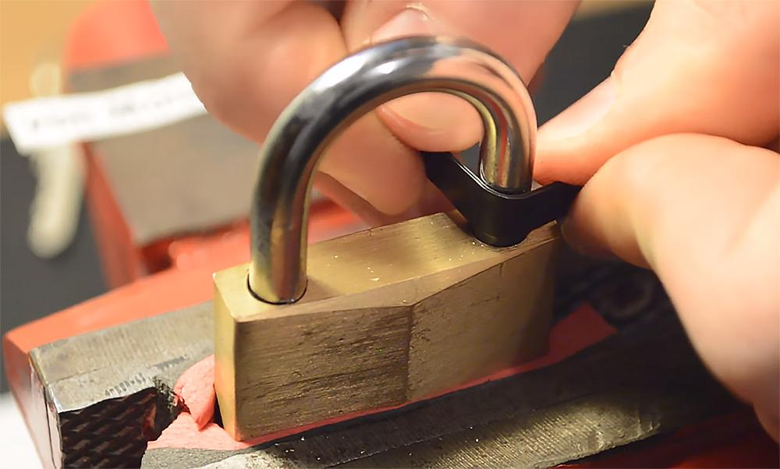
The Attacks
2. Attacking The Padlock Hardware
- The Locking Mechanism:
—> Padlock shimming:
https://www.offgridweb.com/survival/the-basics-of-lock-shims/

Slide 80
The Attacks
2. Attacking The Padlock Hardware
- The Locking Mechanism:
—> Padlock shimming:
It works!
Great software but bad hardware!
https://www.offgridweb.com/survival/the-basics-of-lock-shims/

Slide 81
The Attacks
2. Attacking The Padlock Hardware
- The Casing:

Slide 82
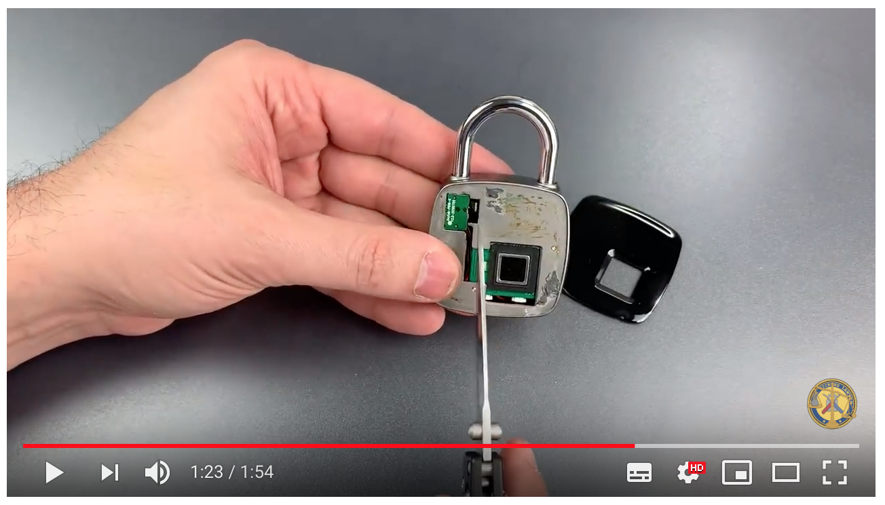
The Attacks
2. Attacking The Padlock Hardware
- The Casing:
https://www.youtube.com/watch?v=uVvEkcN5tW8

Slide 83
The Attacks
2. Attacking The Padlock Hardware
- The Casing:
—> Simply lifting the cover
https://www.youtube.com/watch?v=uVvEkcN5tW8

Slide 84
The Attacks
2. Attacking The Padlock Hardware
- The Casing:
—> Simply lifting the cover
Works great!
Leaves a tiny trace but with a bit of practice it would get easier
https://www.youtube.com/watch?v=uVvEkcN5tW8

Slide 85
The Attacks
3. Attacking The Software:

Slide 86
The Attacks
3. Attacking The Software:
- Connecting a lock to a computer via usb:

Slide 87
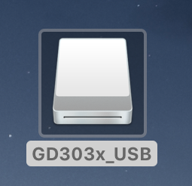
The Attacks
3. Attacking The Software:
- Connecting a lock to a computer via usb:

Slide 88
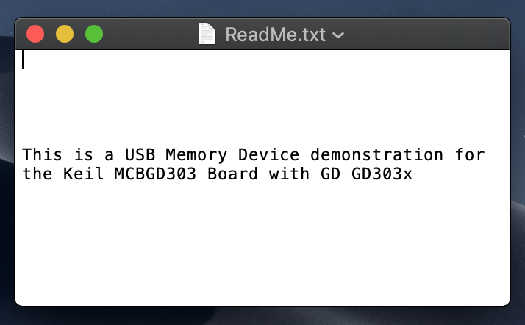
The Attacks
3. Attacking The Software:
- Connecting a lock to a computer via usb:
—> ReadMe.txt

Slide 89
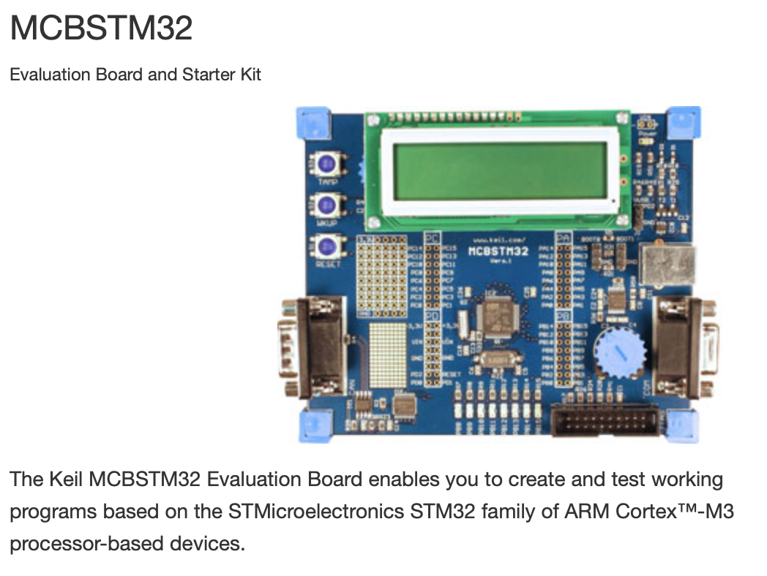
The Attacks
3. Attacking The Software:
- Connecting a lock to a computer via usb:
—> ReadMe.txt
—> Keil evaluation board

Slide 90
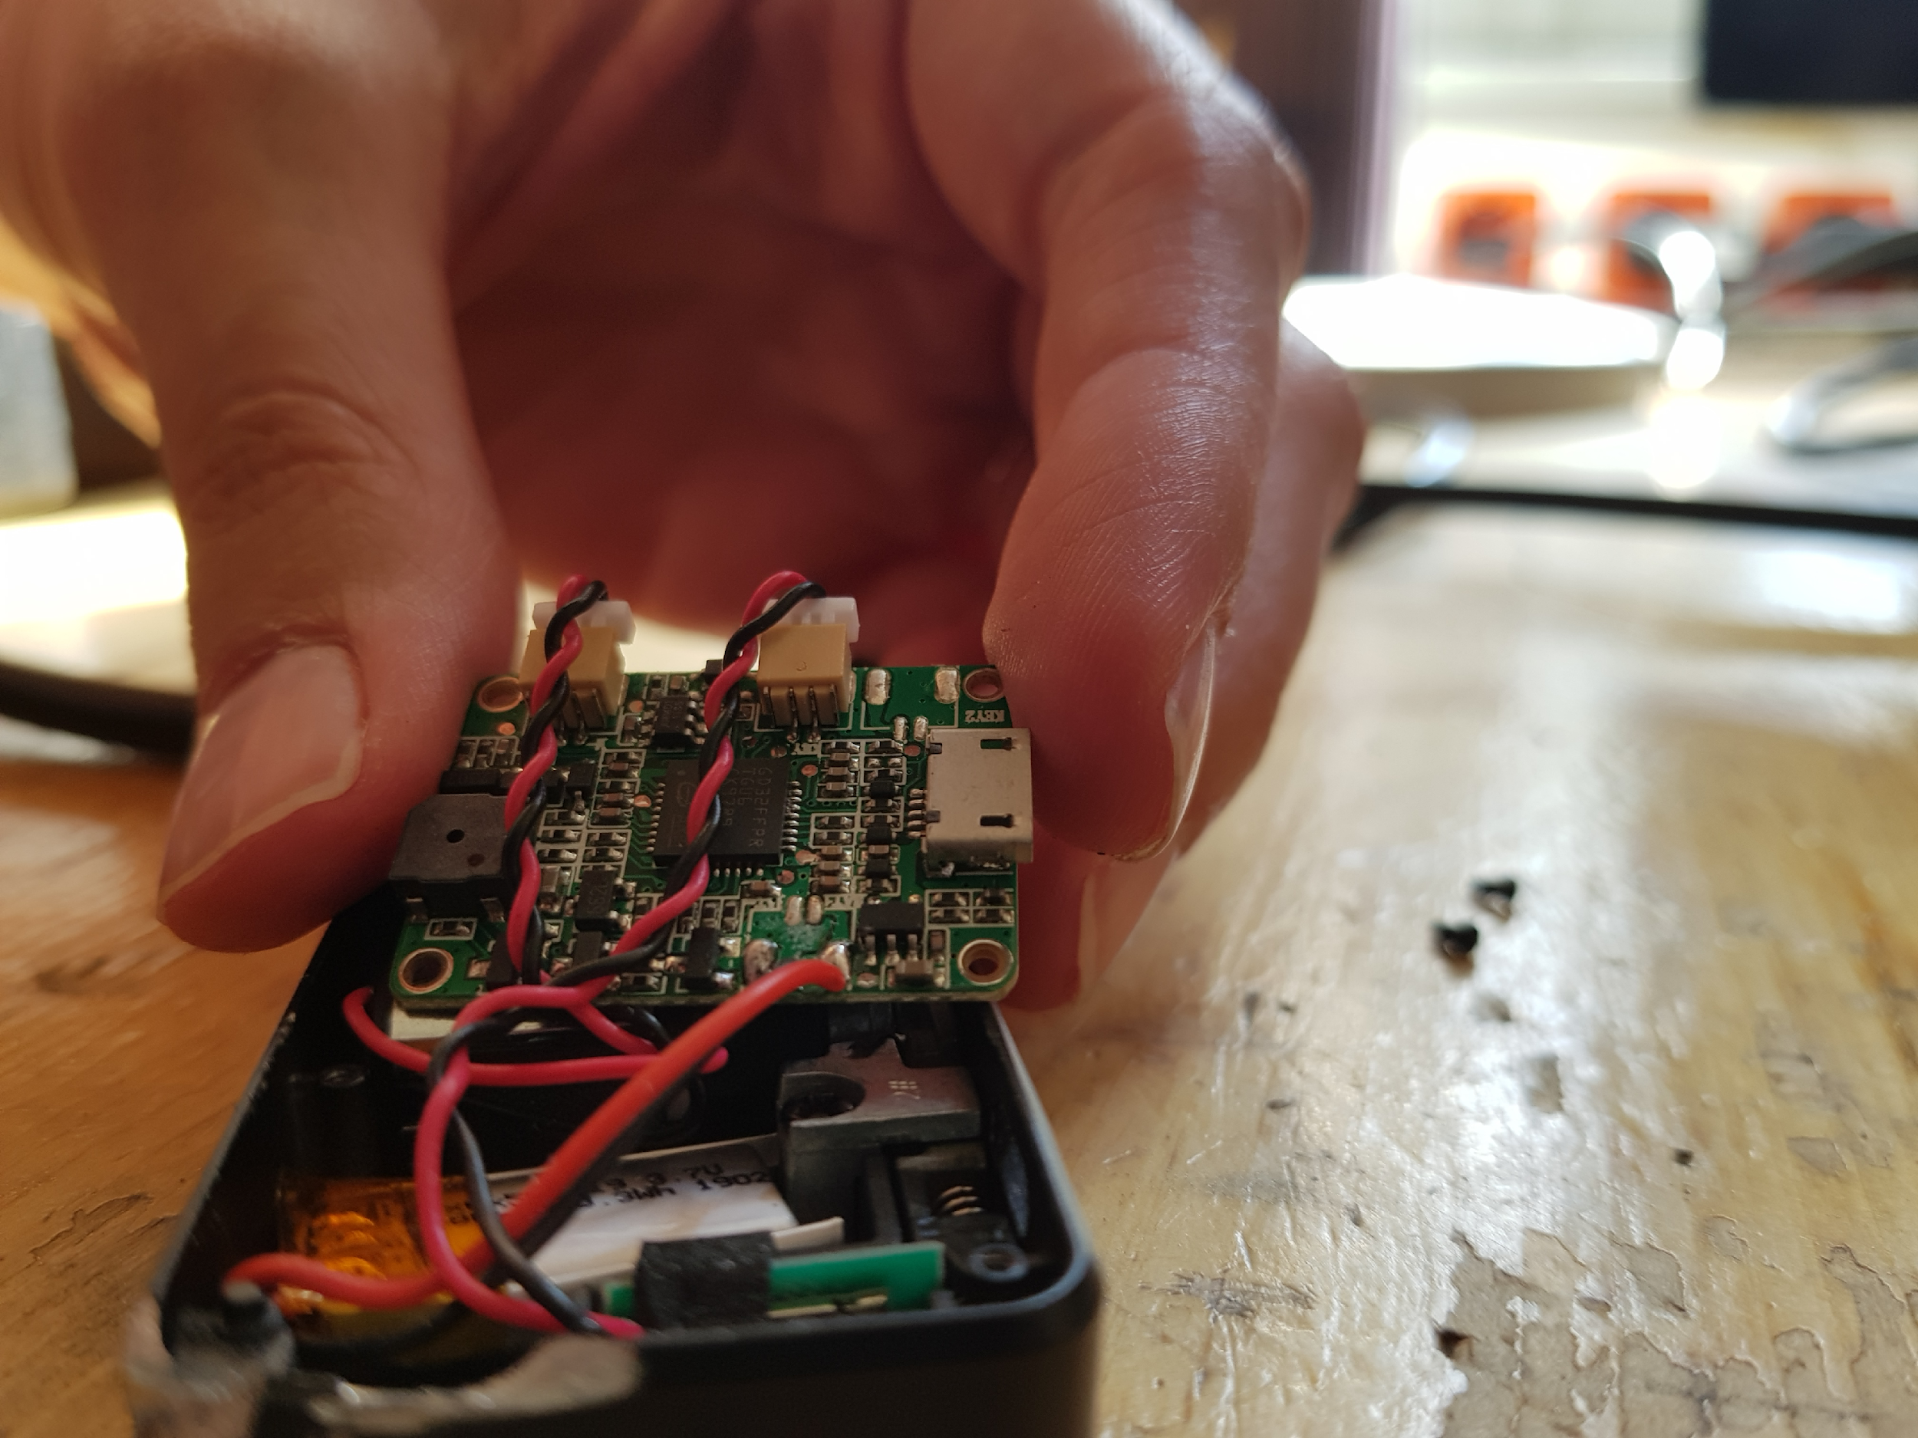
The Attacks
3. Attacking The Software:
- Connecting a lock to a computer via usb:
—> ReadMe.txt
—> Keil evaluation board
—> Opening it up to get a better look

Slide 91
The Attacks
3. Attacking The Software:
- Connecting a lock to a computer via usb:
—> ReadMe.txt
—> Keil evaluation board
—> Opening it up to get a better look
—> Next steps: Either getting the firmware or writing & dropping a hex file onto the chip

Slide 92
References
- Davide Maltoni, Fingerprint Recognition (http://icb12.iiitd.ac.in/Fingerprint-ICB2012.pdf)
- Prateek Joshi, Fingerprint Recognition (https://prateekvjoshi.com/2012/07/22/fingerprint-recognition/)
- Robert Triggs, How fingerprint scanners work: optical, capacitive, and ultrasonic variants explained (https://www.androidauthority.com/how-fingerprint-scanners-work-670934/)
- Danny Thakkar, Minutiae Based Extraction in Fingerprint Recognition
(https://www.bayometric.com/minutiae-based-extraction-fingerprint-recognition/)
- Parth Shah, Ultrasonic Fingerprint Scanner vs Optical Fingerprint Scanner: How Do They Differ (https://www.guidingtech.com/ultrasonic-fingerprint-scanner-vs-optical-fingerprint-scanner-how-do-they-differ/)
- Tom Harris, How Fingerprint Scanners Work, Analysis (https://computer.howstuffworks.com/fingerprint-scanner4.htm)
- Tom Harris, How Fingerprint Scanners Work, Capacitance Scanner (https://computer.howstuffworks.com/fingerprint-scanner3.htm)
- The Verge, Galaxy S10’s ultrasonic fingerprint reader is amazing (https://www.theverge.com/2019/2/20/18232113/samsung-galaxy-s10-plus-fingerprint-sensor-screen-reader-ultrasonic-protector)
- Tsutomu Matsumoto, A Case Study for User Identification (http://web.mit.edu/6.857/OldStuff/Fall03/ref/gummy-slides.pdf)
- wikiHow, How to Fake Fingerprints (https://www.wikihow.com/Fake-Fingerprints)
- CCC, Chaos Computer Club breaks Apple TouchID (https://www.ccc.de/en/updates/2013/ccc-breaks-apple-touchid)

Slide 93
Bluetooth Low Energy
Pia Fichtl

Slide 94

What is BLE?
wireless personal area network technology
communication range 10-20 m
low power consumption
runs for months or years on just a button cell
communication with proximity sensors, heart rate monitors, and fitness devices possible
low cost, small, fast pair/connection times
intended uses: smart home, healthcare, fitness, security

Slide 95
GATT
Attribute Protocol (ATT): specifies how two BLE devices send and receive messages
Generic Attribute Profile (GATT):
built on top of ATT
specifies sending and receiving short pieces of data (“attributes”) over BLE link
LE application profiles are all based on GATT
standard ways in which services, characteristics (discovering, reading, writing, notifying and indicating), descriptors are found and used to transfer data

Slide 96
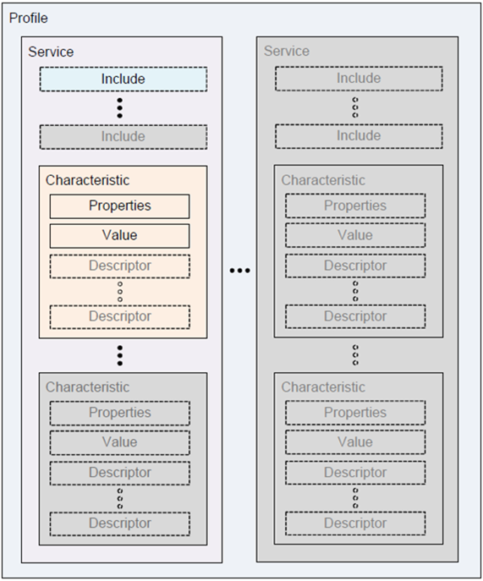
Source: https://www.bluetooth.com/specifications/gatt/generic-attributes-overview/

Slide 97
Profile
specifies how a device works in a particular application
multiple profiles on one devices possible
e.g. blood pressure profile, location and navigation profile,…
composed of one or more services necessary to fulfill a use case
appropriate implementation up to manufacturer

Slide 98
Service
collection of characteristics (“type/class”)
descriptor: describes characteristic value, e.g. human-readable description, acceptable range for a characteristic's value, …
connection is not exclusive, no permanent connection is needed
hierarchical organization
keep data transferred minimal
save battery

Slide 99
example: Smartwatch
Service „heart rate monitor“, Characteristic „heart rate measurement”, “alert high heart rate”
Service “location”, ...
Source: https://www.bluetooth.com/specifications/gatt/generic-attributes-overview/

Slide 100
Connection
scanning: devices send packages to and listen to the advertisement channel in specific intervals
two devices „meet“ (sending and listening in same phase): connect and go to a data channel

Slide 101
Security
Bluetooth link layer security:
pairing (“handshake exchange” between the 2 devices when first connection)
JustWorks, 6-digit PIN, Out of band
bonding “for connecting again later”
establish & store a long term key
encryption ( while exchanging data)
often: AES and static secret

Slide 102
Security
BUT: many devices (including smart locks) don‘t use link layer security
often use own communication protocol with unencrypted BLE link
interception possible!

Slide 103
Attacks
MITM: emulate original device, connect with app, get the data sent back and forth
record „handshake“ data -> replay, e.g. with nrF Connect -> now our device is connected
tools: GATTack, btlejack

Slide 104
nRF Connect
Scanning, Reading, Writing Functionalities
get infos, e.g. IP, device type, ...
read advertisements and services
clone a device
Macros: Run & Replay Exchanges by using XML file
get a file from GATTack and replay actions

Slide 105
btlejack
uses a specific mini computer
not useful for us
MITM: use the battery-saving timeout function of BLE: intercept signal of original target device, timeout -> connection broken, btlejack pretends to be the target device and connects with other device

Slide 106
GATTack
often no pairing & link-layer encryption -> vulnerable
only a bluetooth adapter and Raspberry Pi or similar needed
MITM: copy the original device, connect to app instead of it, get data, but still forwards it to original -> intercept and/or modify requests and responses
Uses:
disrupting functionality (Denial of Service): user can’t get service from BLE device
spoofing (giving wrong info to the user)
Intercepting data (personal infos, … )
Controlling the device

Slide 107
So far so good...
tool hasn’t updated in 2 years
takes a lot of work to make it run
scanning for devices and general info works
device services and characteristics can be read if no encryption
get .json files with data
can be used to clone the device and advertise as it

Slide 108
So far so good...
we spoof the MAC address by using the bdaddr tool and then advertise as the lock
the app connects to us
we can monitor communication or send infos to the phone
the script for that isn’t working
similar github issues that aren’t solved
tried to change the MAC address manually, then advertise
no success yet
trouble configuring functions, not enough documentation
or unexpected security at this step

Slide 109
Next steps
try to find a working hook configuration
open github issue and hope for an answer!

Slide 110
gatttool & hcidump
monitor bluetooth connections
for some locks this shows that security is in place
services & characteristics can’t be read by gatttool

Slide 111
Sources
https://developer.android.com/guide/topics/connectivity/bluetooth-le
https://learn.adafruit.com/alltheiot-transports/bluetooth-btle
https://de.wikipedia.org/wiki/Bluetooth_Low_Energy#Verbindungstypen
https://www.bluetooth.com/specifications/gatt/generic-attributes-overview
https://www.golem.de/news/golem-de-programmiert-bluetoothle-im-eigenbau-1404-105896-2.html
https://smartlockpicking.com/tutorial/how-to-pick-a-ble-smart-lock-and-cause-cancer/
https://github.com/securing/docs/blob/master/slides.pdf
https://www.heise.de/download/product/btlejack
https://www.heise.de/security/meldung/Btlejack-Neues-Gratis-Tool-zum-Belauschen-von-Bluetooth-Verbindungen-4134142.html
https://github.com/securing/gattacker
https://www.jaredwolff.com/get-started-with-bluetooth-low-energy/#show1

Slide 112
Client Server Communication
based on the SLok Smart Lock

Slide 113
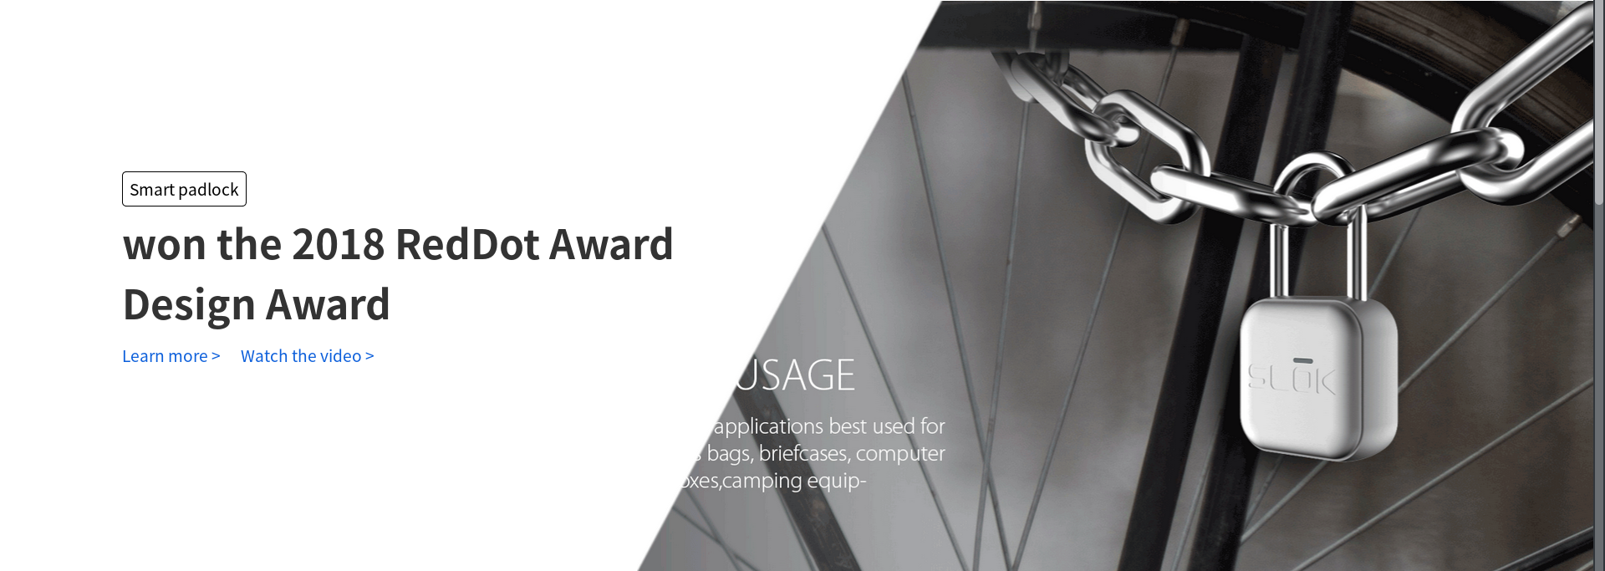
The SLOK Smart Lock
source: http://www.myslok.com/slokweb/web_public/html/en/index.php

Slide 114
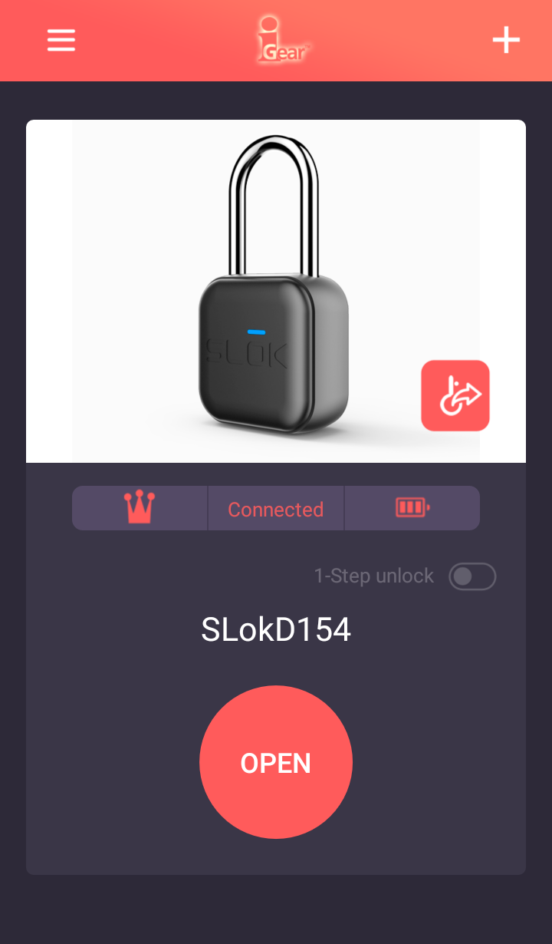
The SLOK Smart Lock
app based system
slok
iGear SLok
Klic Slock
...
an user account is needed

Slide 115
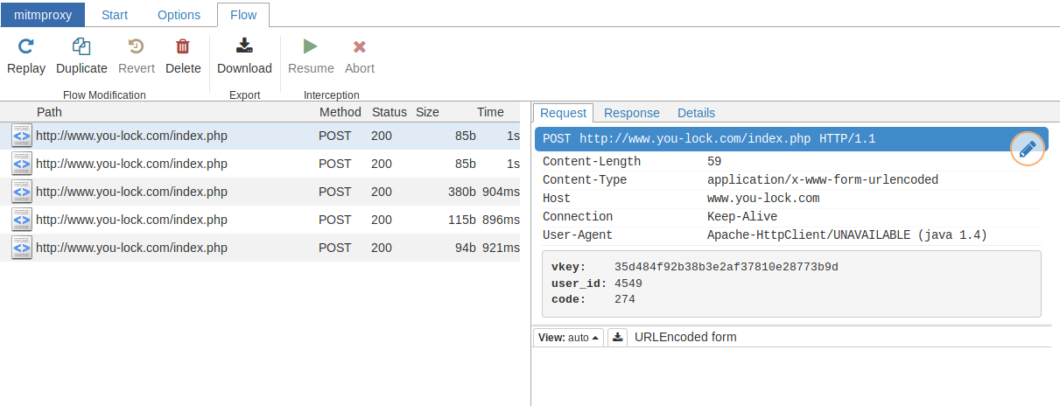
Getting Started ...
checking the client-server communication with MITMProxy

Slide 116
MITMProxy & jadx
decompiled android app with jadx
identified a huge list of commands
for general use case:
Net_GET_regist : Code 219 → create account
Net_Get_Locks : Code 211 → list locks in account
Net_Add_Lock : Code 231 → add a lock to account
Net_Delete_Lock : Code 233 → remove a lock from account
Net_Submit_Record : Code 251 → open lock

Slide 117
Test the API ...
tried to send an own request with some data
ooops ...
Response {
result : -2318
error : \u6b64\u9501\u5df2\u88ab\u7ed1\u5b9a!
}

Slide 118
Having a deeper look
obviously something must have been wrong

Slide 119
Having a deeper look
obviously something must have been wrong
first try → replay a recorded request : worked
so there must be some kind of verification

Slide 120
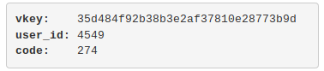
Having a deeper look
searched the java code on how the requests get created
each request consists of
a number of parameter
the vkey

Slide 121
Having a deeper look
searched the java code on how the requests get created
each request consists of
a number of parameter
the vkey
create an url-string of the key-value pairs ordered by key name
$url_str = “user_id=4549&code=274”
get the users password
$pw = “<the_users_password>”
create the vkey as:
vkey = md5( $url_str + md5( $pw ) )

Slide 122
Using the API
having the vkey-mechanism
created a python based client for API interaction
though about possible attacks
online / offline brute force the users password
take over an already existing lock
hardware attacks

Slide 123
Online / Offline Brute Force Attack
Online
idea: get a valid response for a request
we know
vkey mechanism
setup of different requests
generate passwords and create the matching vkey → ask the API
pro
easy
con
takes lot of time (request - response)
(a good) API could lock the user
depends on password length

Slide 124
Online / Offline Brute Force Attack
Online
idea: get a valid response for a request
we know
vkey mechanism
setup of different requests
generate passwords and create the matching vkey → ask the API
pro
easy
con
takes lot of time (request - response)
(a good) API could lock the user
depends on password length
Offline
idea: take an valid vkey and reverse the password
we know
vkey mechanism
pro
API independent
con
need a good CPU (150K Hashes / s)
better take a GPU (150M Hashes / s )
depends on password length

Slide 125
Take over an existing lock
involves creating an own API implementation
easy, as most responses are only “result : 1”
needed commands
Net_Add_Lock : Code 231 → add a lock to account
Net_Submit_Record : Code 251 → open lock

Slide 126
Take over an existing lock
involves creating an own API implementation
easy, as most responses are only “result : 1”
needed commands
Net_Add_Lock : Code 231 → add a lock to account
Net_Submit_Record : Code 251 → open lock
ooops … to fast
a successful request would return the locks “key”
but what to return in a faked API?

Slide 127
The locks key
one can get the correct key by to options
Net_Get_Locks : Code 211 → list locks in account
Net_Submit_Record : Code 251 → open lock
option 1 involves breaking the password → brute force
option 2 try to find out how the “key” works

Slide 128
The locks key
already while playing around I figured out
key always the same for different users

Slide 129
The locks key
already while playing around I figured out
key always the same for different users
first try : Is the key random or deterministic?

Slide 130
The locks key
already while playing around I figured out
key always the same for different users
first try : Is the key random or deterministic?
deterministic
lock would not open with a randomly generated key (own API)

Slide 131
The locks key
second try : Which parameter could influence the key?
email [user]
phone [user]
md5( password ) [user]
user_name [user]
user_id [API]
lock_name [API]
lock_mac [API]
lock_num [API]
guanlian_id [API]

Slide 132
The locks key
second try : Which parameter could influence the key?
email [user]
phone [user]
md5( password ) [user]
user_name [user] different for for 2 users
user_id [API]
lock_name [API]
lock_mac [API]
lock_num [API]
guanlian_id [API]

Slide 133
The locks key
second try : Which parameter could influence the key?
email [user]
phone [user]
md5( password ) [user]
user_name [user] different for for 2 users
user_id [API]
lock_name [API] different names with different users did no changed key
lock_mac [API]
lock_num [API]
guanlian_id [API]

Slide 134
The locks key
third try : one mac - key pairs is way to less
asked the API with 1000 random mac-addresses
mac | key
56:09:80:4C:C0:10 | 0161701d26ce8854
18:F2:0A:B2:C4:17 | 0180c7d7f141335c
... | ...
A1:E5:8F:D7:AC:F4 | 0142bceed72efe7d

Slide 135
The locks key
fourth try : checking php’s hash functions
functions
md[ 2 | 4 | 5 ]
sha[ 1 | 224 | 256 | 384 | 512/224 | 512/256 | 512 | 3-224 | 3-256 | 3-384 | 3-512 ]
ripemd[ 128 | 160 | 256 | 320 ]
whirlpool
tiger[ 128,3 | 160,3 | 192,3 | 128,4 | 160,4 | 192,4
…
tests
single hash, double hash
upper- / lowercase mac
with- / without mac

Slide 136
The locks key
fifth try : try calculating
what we know
mac-address : 12 hex chars - 6 blocks of 8 bit = 48 bit
key : 16 hex chars, always starting with 01 → 1 + 7 blocks of 8 bit = 8 + 56 bit
maybe there is a calculaton involved
addition, subtraction, multiplication (mod 256)
for Byte 1 / 7 being a kind of checksum

Slide 137
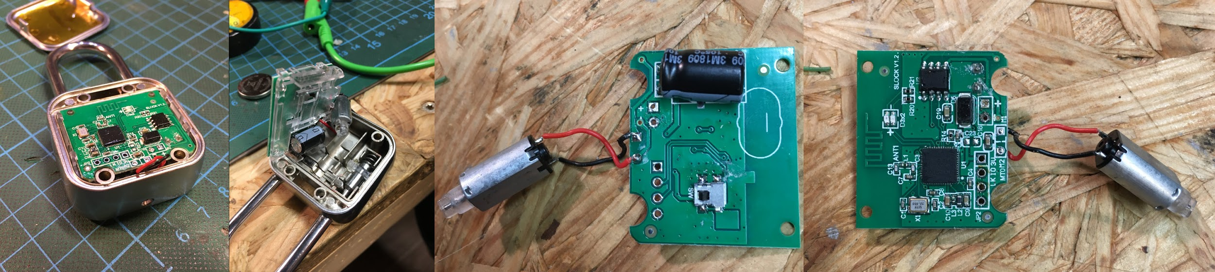
Hardware Attack
legally no real chance to get API code
other option → check the firmware

Slide 138
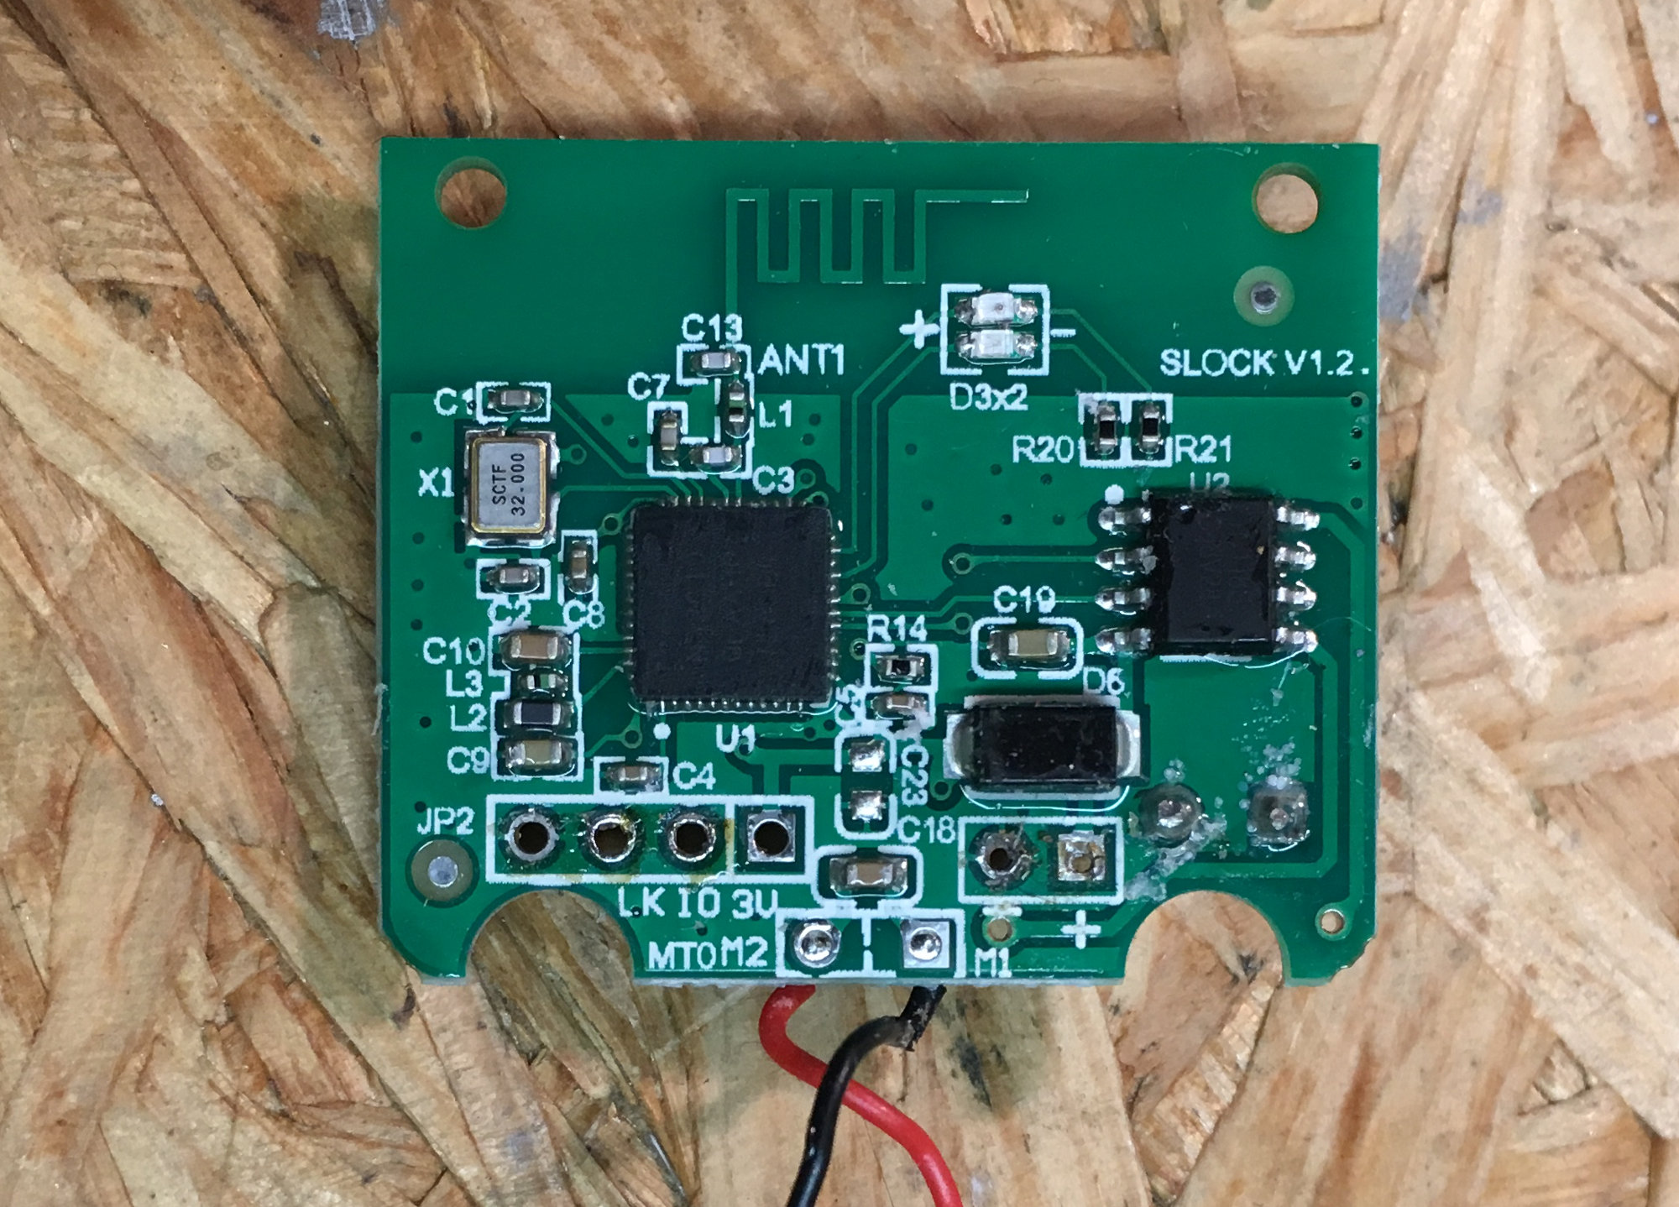
Hardware Attack
chip
Nordic Semiconductor NRF N52810
ARM Cortex M4 32 Bit CPU, 64 MHz
192 KB Flash
24 KB RAM
SWD debugging port
tried
different serial - USB converter
need a special adapter for SWD

Slide 139
Thank you for your attention!
… and I’m open for questions!

